Slide 1
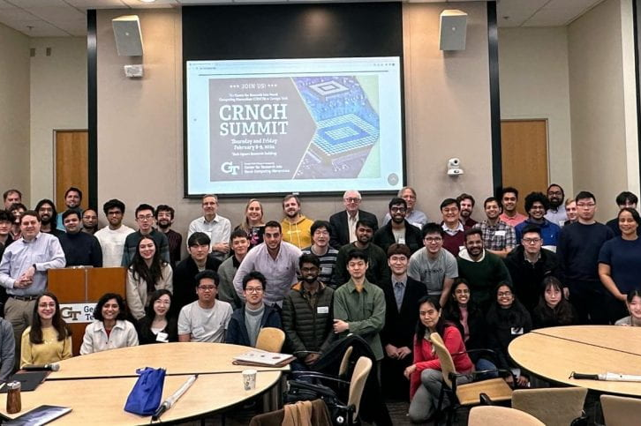
CRNCH Summit, 2025—Welcome!
February 13-14
Hyesoon Kim (CS)
& Rich Vuduc (CSE),
Co-directors
Tushar Krishna (ECE),
Assoc. Dir.
Callie Hao (ECE),
Co-organizer
Attendees at the 2024 CRNCH Summit

Slide 2

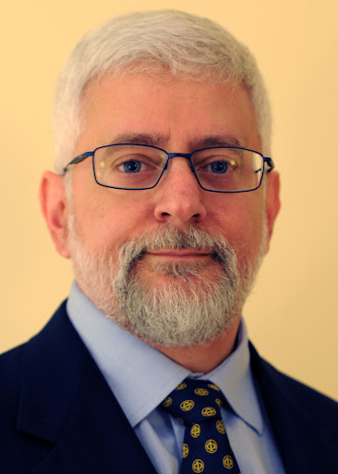
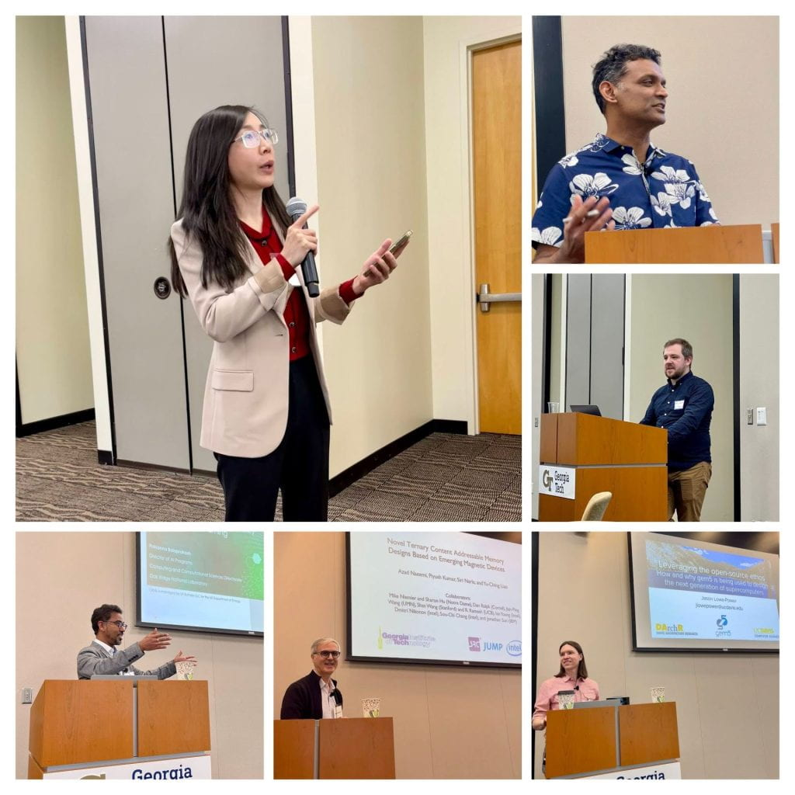
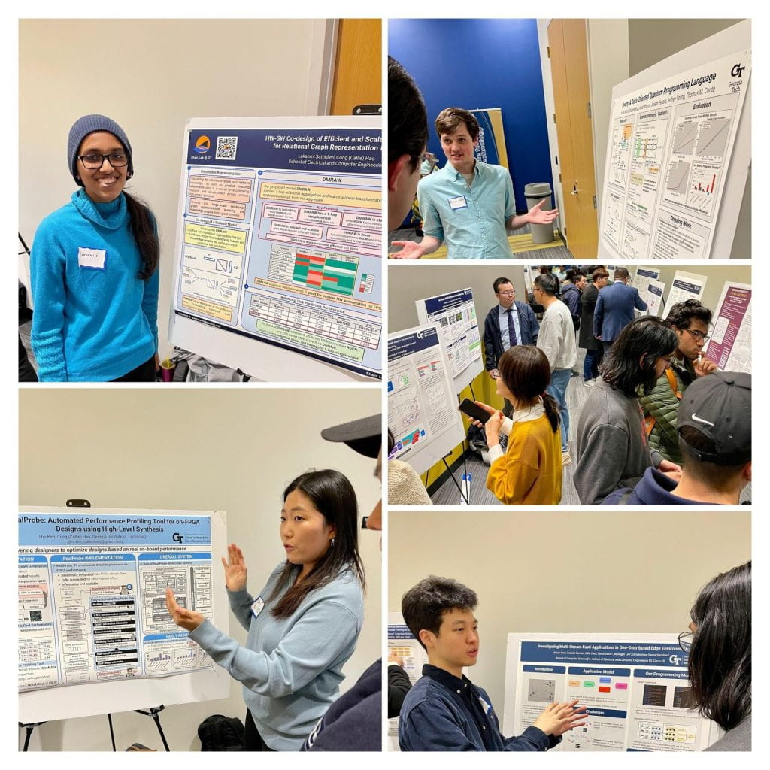
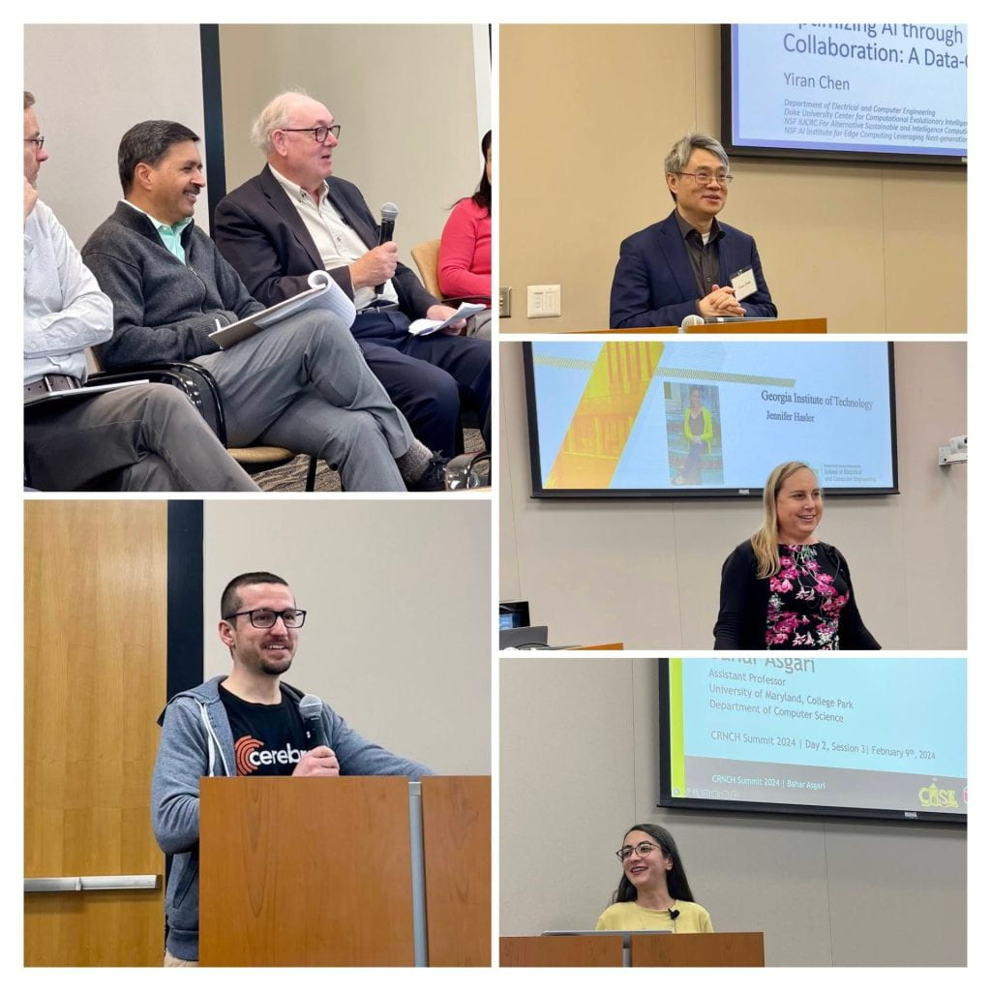
What is CRNCH?
CRNCH is an outgrowth of the IEEE Rebooting Computing Initiative, co-founded by Tom Conte (GT). Tom formed CRNCH in 2015, partnering with David Bader, Rich DeMillo, Dick Lipton, and Marilyn Wolf. Tom was joined by Vivek Sarkar as co-director in 2018.
CRNCH is the Center for Research on Novel Computing Hierarchies. Its goal is to help researchers at GT (and beyond!) develop community and large-scale research and education programs in post-Moore’s Law computing.
(2012)
Tom Conte
(GT; CRNCH Founding Director)
Attendees at the 2024 CRNCH Summit

Slide 3
2024 CRNCH Affiliated Projects and Activities
FORZA: iARPA AGILE project (~ $15M) on codesigning architectures and runtimes with graph analytics applications
Rogues Gallery: NSF CCRI ($1.3M): Ended in October, but RG is active and a $2M renewal proposal is under review
RUN-DMX: NSF PPoSS Large ($4M) on ”smart communication devices” (NICs, memory, storage)
CRNCH Ph.D. Fellowship: 3 recipients (CSE, CS, ECE) (18 total since 2020)
CRNCH-Intel Undergraduate Travel Grant: 1 recipient (so far!)
Education: Two VIP classes (Future Computing with the Rogues Gallery and Team Phoenix)

Slide 4
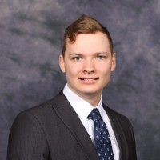
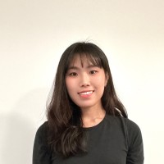
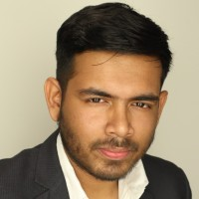
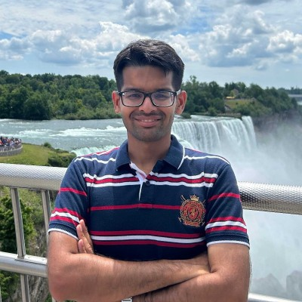
2024-2025 CRNCH Fellows — Meet @Poster Session
Ben Wilfong [www]
“Optimizing fluid flow solvers for superchip architectures”
School of Computational Science and Engineering
Advisors: Spencer Bryngelson, Aaron Jezghani
Suyeon Lee [www]
“Asynchronous streaming for (CXL-based) computational remote memory”
School of Computer Science
Advisor: Ada Gavrilovska
Md Mizanur Rahaman [LinkedIn]
“SOT-MRAM-based vector symbolic macro for hyperdimensional computing”
School of Electrical and Computer Engineering
Advisor: Azad Naeemi
Dhruv Garg [LinkedIn]
“Robust FFL: Federated fine-tuning of LLMs in highly unavailable conditions”
School of Computer Science
Advisor: Alexei Tumanov
Notes:
https://sites.google.com/view/sylee0506
https://www.linkedin.com/in/md-mizanur-rahaman-nayan-837361155/

Slide 5
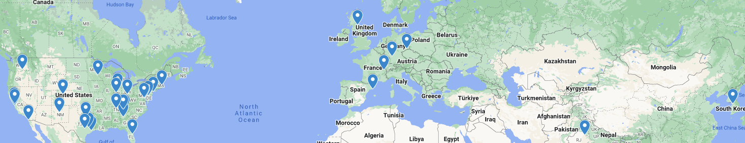
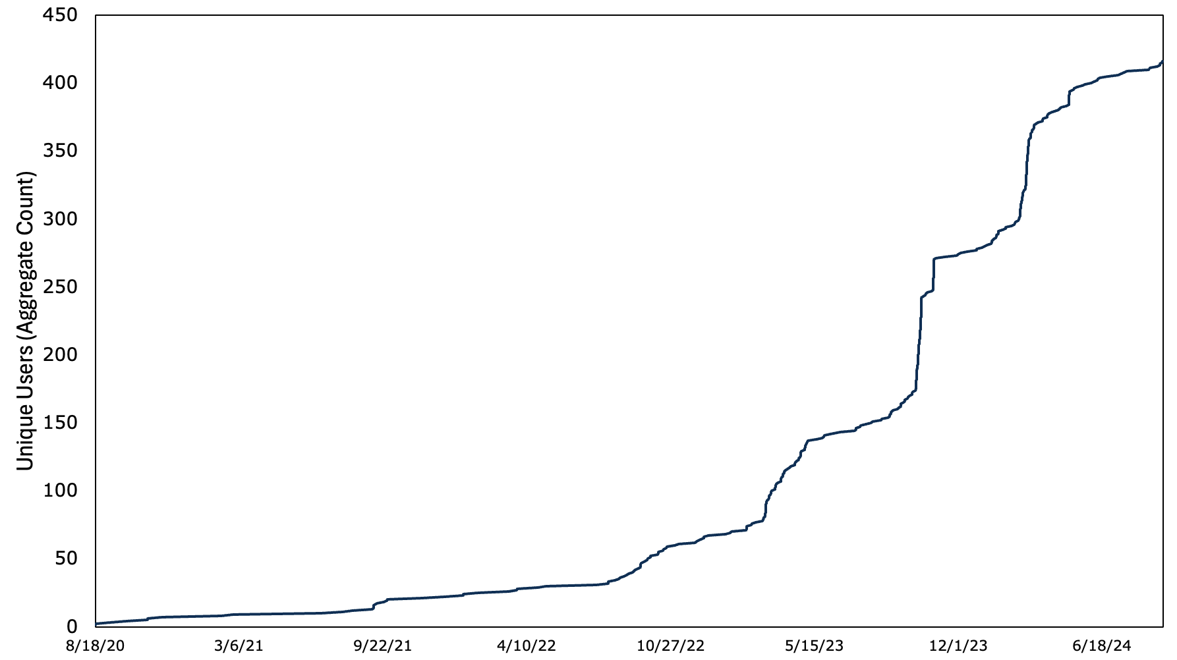
Outreach via Infrastructure: The Rogues Gallery
A significant CRNCH asset is the Rogues Gallery Testbed for experimental architecture evaluation, led by Jeff Young, RG serves both our projects and those of the broader NSF CISE community.
Firsts: Open A64FX testbed, Pynq FPGA cluster, Lucata Pathfinder (Graph500), FPAA
Cited in 25 peer-reviewed publications by NSF CISE researchers
Supported 15 workshops, 13 tutorials since 2020
400+ users
(80 external)

Slide 6
2024 RG-enabled Outreach
We increased the number of CRNCH outreach activities in 2024 (from four in 2023 to seven in 2024).
All materials are archived on the CRNCH website and continue to attract collaborations and other external engagements.
SC24 BoF: Advanced Architecture “Playgrounds” — Past Lessons, Current and Future Accesses of Testbeds
SC24 Tutorial: Leveraging SmartNICs for HPC and Data Center Applications
SC24 Panel: Hilbert’s Problems for HPC — What should the community work on next?
MICRO24 Tutorial: Vortex Workshop and Tutorial
HotInterconnects’24 Tutorial: Leveraging SmartNICs for HPC and Data Center Applications
FCCM24 Tutorial: Understanding Your FPGA Design Better: From Rapid Simulation to On-board Profiling (Callie Hao)
SIAM PP24 Minisymposium: Smart Networks in HPC: For Fun or Profit (or Both)? – SIAM PP Minisymposiums on SmartNICs

Slide 7
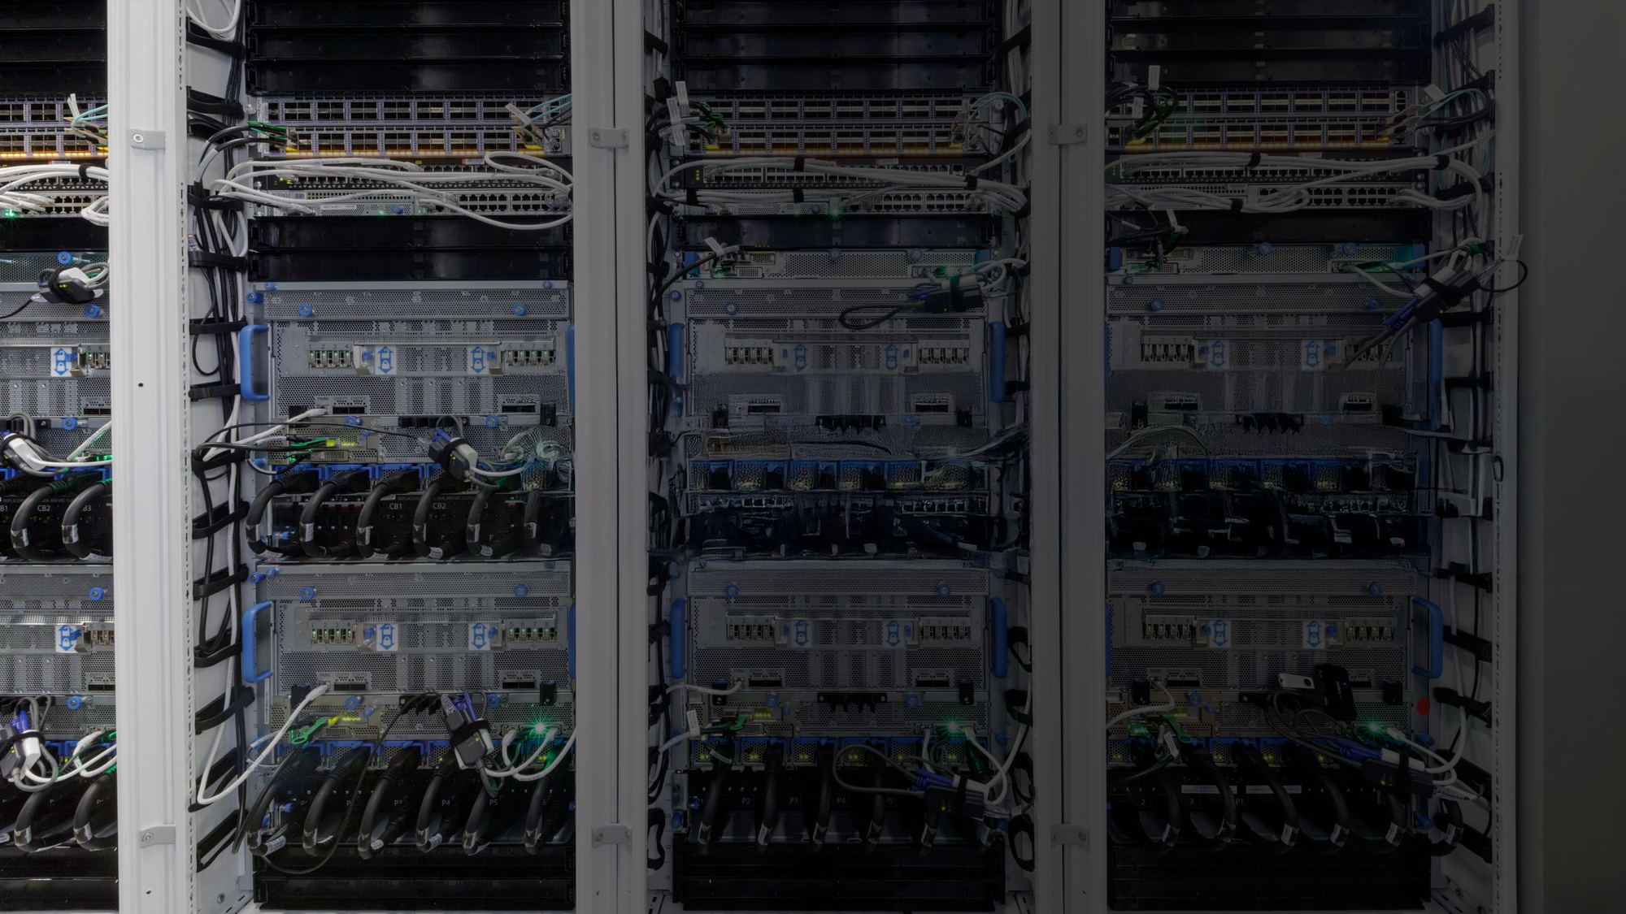
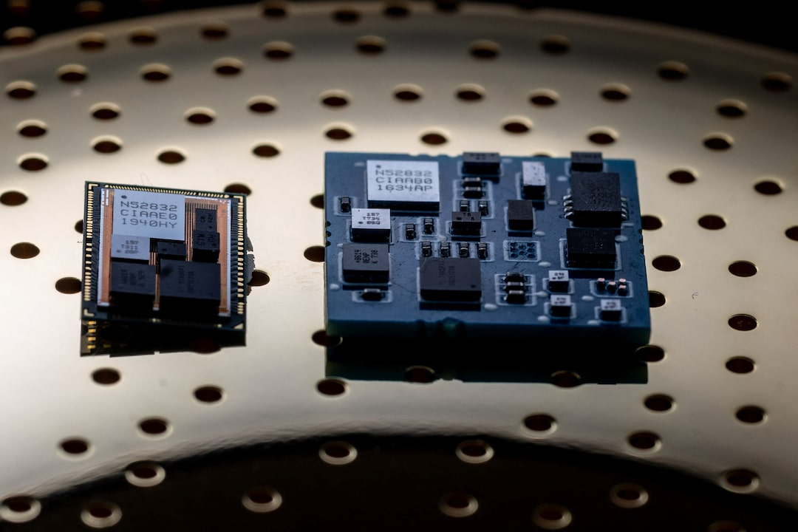
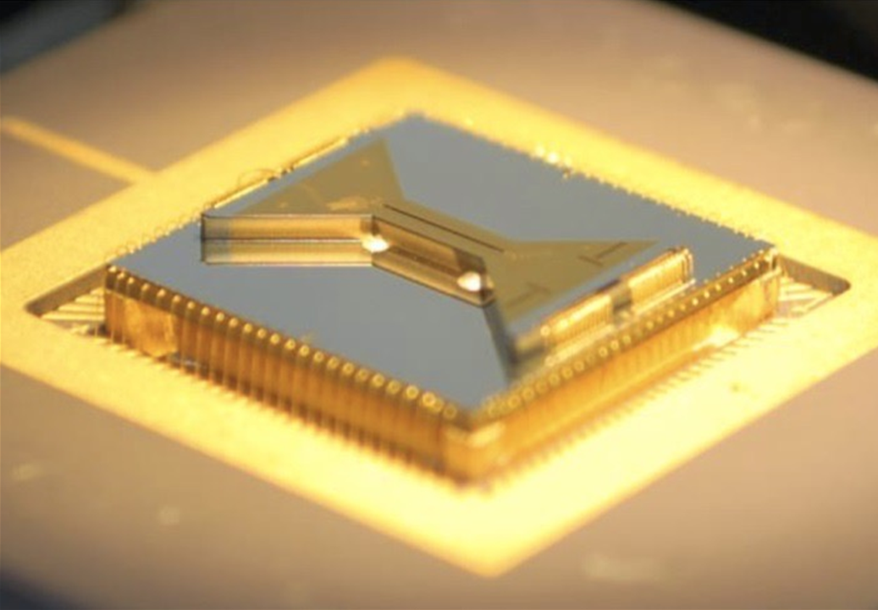
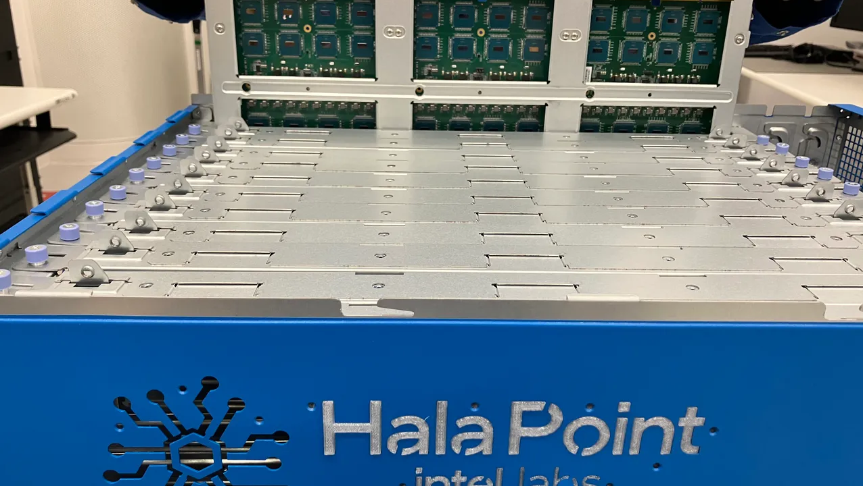
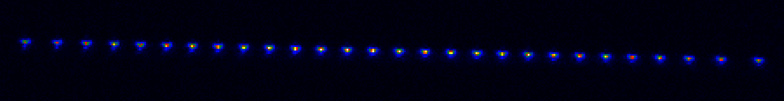
Source: Glen Lockwood (Microsoft) + Adobe Photoshop 2025 GenAI fill
zGlue demo chips. Source: Reuters
2025 Summit Theme: Next-generation infrastructure is here—now what?
……………
Ion trap device. Source: 2024 STAQ Summer School
Intel Hala Point. Source: ZDNet

Slide 8
Source: Glen Lockwood (Microsoft) + Adobe Photoshop 2025 GenAI fill
zGlue demo chips. Source: Reuters
2025 Summit Theme: Next-generation infrastructure is here—now what?
The future of hardware technologies for computing (09:00-09:45)
Subhasish Mitra (Stanford)
Bottom-up medical superintelligence (08:45-09:30)
Niraj Jha (Princeton)
Device Building Blocks (09:55-10:45)
Khan (GT), Yu (GT)
Edge to Clouds (09:40-10:55)
Runner (Xcelerium), Rastegari (Microsoft), Youssef (IBM)
Chiplets Won (10:55-11:45)
Olofsson (ZeroASIC), Sinclair (Wisconsin)
GPUs are Still the Future (11:05-12:20)
Beckmann (AMD), Ranade (LPS), Thakkar (NVIDIA/GT)
Day 1
(Lunch) Energy-efficient computing: Do we have a roadmap? (11:45-13:00)
Peter Kogge (Notre Dame)
(Lunch) ChatHPC: GenAI for HPC (12:20-13:35)
Keita Teranishi (ORNL)
Day 2
(Panel) Now what? (13:35-14:20)
Conte (GT) - Moderator; Panelists: Runner (Xcelerium), Sinclair (Wisc), Simon (UMBC), Young (GT), Rastegari (Microsoft)
Beyond GPUs (13:00-13:25)
Nurvitadhi (Mangoboost), Daglis (GT), Mahajan (GT)
……………
H/W for Novel Models (14:35-15:50)
Brown (Duke), Aimone (Sandia), Michelogiannakis (LBNL)
crnch.gatech.edu
Posters (16:00-17:15)
(Panel) What if the US loses semiconductor leadership? (17:15-18:00)
Datta (GT) - Moderator; Panelists: Olofsson (ZeroASIC), Heck (GT), Beckmann (AMD), Nurvitadhi (Mangoboost), Lin (GT)
For guest wifi, use `GTVisitor`
Ion trap device. Source: 2024 STAQ Summer School
Intel Hala Point. Source: ZDNet

